Slide 1
SONA COLLEGE OF TECHNOLOGY Departmant of Electrical and Electronics Engineering U15EE801R Project Work (2020-21)
Team Number : 33
Project Title : Water Quality Monitoring System Using IOT
Team Supervisor: Dr.R.Shivakumar, ME.,Ph.d.,
Team Members :
Gokulprasanth - 1517104705
Kavihasan S - 1517104711
Lokesh P K - 1517104712
Date: 29.04.2021

Slide 2
Aim:
To Identify the parameters of water quality Using IOT to identify the pH, Turbidity And Temperature in the water.
Objectives:
This project contributes in the direction of monitoring the quality of water.
The sensors measures the pH, conductivity, temperature,and presence of suspended items on the water bodies like lakes and rivers using sensors.
These sensed parameters are sent to the authorized person via GSM system, so that proper action can be taken by the authority in cleaning the water.

Slide 3
Abstract
Now a day’s water pollution is one of the biggest fear.
To prevent the water pollution, first we have to estimate the water parameter.uch as pH, turbidity, temperature as the variations in the values of these parameters point towards the presence of pollutants.
At present, water parameters are detected by chemical test or laboratory test, where the testing equipments are stationary and samples are provided to testing equipments.
Thus the water quality monitoring system is a manual system with tedious process and is very time consuming.
The measured values from the sensors can be processed by the core controller. The Arduino UNO model can be used as a core controller. Finally, the sensor data can be viewed on SMS using GSM Modem.

Slide 4
Literature Survey
Nikhil Kedia, highlights the entire water quality monitoring methods, sensors, embedded design, and information dissipation procedure, role of government, network operator and villagers in ensuring proper information dissipation.
Niel Andre Cloete et.al, In this paper the development of a a low-cost, wireless, multi-sensor network for measuring the physicochemical water parameters; enabling real-time monitoring, is presented.
Pradeepkumar M, system consists of Turbidity, pH &Temperature sensors of water quality testing Arduino microcontroller data acquisition module, information transmitted an module, monitoring center and other accessories.
Jayti Bhatt and Jignesh Patoliya , In this system we present the design of IoT Based Water Quality Monitoring System that monitor the quality of water in real time.

Slide 5
Existing System
Traditional methods have the drawbacks such as long waiting time for results high cost, low measurement precision, and complicated methodology.
For monitoring purpose they used Bluetooth and zigbee technology.
But both communication technologies have some disadvantages like they have short distance for communication so the user should be within the range for monitoring parameters.
The data from the sensors are transmitted from the server, couldn’t be uploaded to the cloud server which is due to disconnection at the node during transmitting data from sensors.

Slide 6
Proposed Methodology
The proposed method is used to overcome the drawbacks present in existing method. Here we are using Arduino UNO as core controller and various sensors to monitor the water Quality.
The block diagram of our system is shown in Figure Arduino UNO to manage various types of equipments including sensors and so on.
We are connecting different sensors Arduino UNO to monitor the conditions of water. Arduino UNO will access the data from different sensors and then processes the data.
The sensor data can be viewed on SMS using GSM Modem

Slide 7
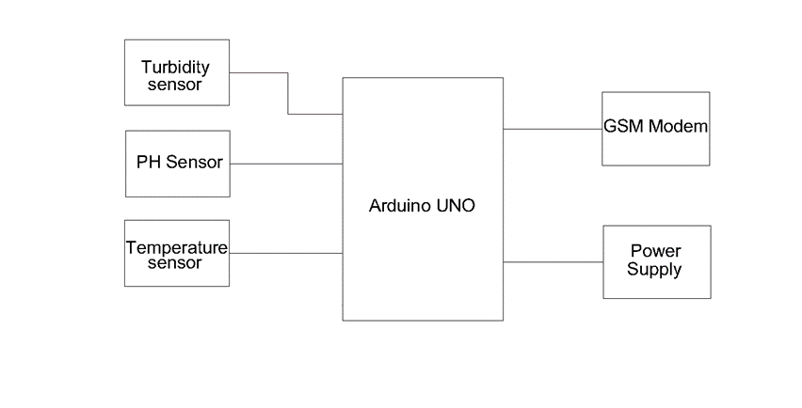
Block Diagram

Slide 8
Explanation
Turbidity sensors measure the amount of light that is scattered by the suspended solids in water.
As the amount of total suspended solids in water increases, the water’s turbidity level increases.
A pH sensor helps to measure the acidity or alkalinity of the water with a value between 0-14.
When the pH value dips below seven, the water starts to become more acidic. Any number above seven equates to more alkaline.
A temperature sensor is an electronic device that measures the temperature of its environment and converts the input data into electronic data to record, monitor, or signal temperature changes.
it Processes the data from sensors and sends the SMS to the Client whenever The Sensor Readings are reaches the Particular level,
it sends SMS command to GSM Modem ,Gsm module Process the data and sends SMS to the particular numbers.

Slide 9
Components used
S NO. | APPARATUS | TYPE/ RANGE | QUANTITY
1 | Turbidity Sensor | SEN0189 | 1
2 | Arduino UNO | ATMEGA320 | 1
3 | GSM Module | SIM800C/12V | 1
4 | DC Adapter | 12V/1.5A | 1
5 | pH Sensor | SEN0161 | 1
6 | Temperature Sensor | DS18B20 | 1
7 | Voltage Regulator IC | 7805,7809 | Each 1
8 | Connecting Wires | - | -

Slide 10
Arduino UNO
Arduino is used to communicate with a computer, another Arduino, and other microcontrollers.
The ATmega328p microcontroller which is equipped on the Arduino board provides UART TTL (5V) serial communication which can be achieved using digital pin 0 and digital pin 1.
An ATmega16U2 channels this serial communication over the USB port and appears as a virtual com port to software on the computer.
An ATmega16U2 firmware uses the USB com drivers and no other external drivers are required to communicate with the OS of a computer.

Slide 11
Turbidity Sensor
Turbidity is the measure of a number of particles in the water.
We used Turbidity Sensor(SEN0189) for measuring the Turbidity which is shown in Figure.
Turbidity is measured in Nephelometric Turbidity Units (NTU). It is taken as the optical property of water and is an expression of the amount of the light that is scattered by the suspended particles in the water when a light is shined through the water sample.
As the intensity of scattered light is increased, the turbidity increases

Slide 12
PH Sensor With TDS
pH sensor (SKU:SEN0161) is a sensor which detects pH value of water The term “pH” set off from Latin and is an acronym for “potential hydrogenii” or “the power of hydrogen”.
pH is the hydrogen-ion concentration in water-based solutions, which indicates the acidity and alkalinity in the solution.
The pH scale is a logarithmic scale whose range is from 0-14 with a neutral point being 7. Values above 7 indicate a basic or alkaline solution and values below 7 would indicate an acidic solution.
It is commonly used in various applications such as agriculture, wastewater treatment, industries, environmental monitoring, etc.

Slide 13
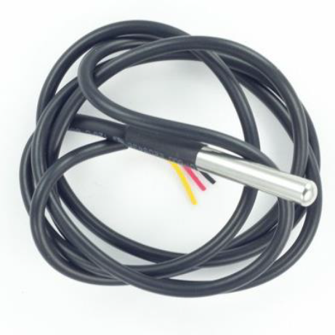
Temperature Sensor
The temperature sensor (DS18B20) used for measuring the temperature of water.
This is shown in Figure 5.When the accurate measurement is needed, we should always consider the temperature.
The increase in temperature of water increases the ionization rate .
pH value as well as turbidity changes with the change in Temperature.
pH is temperature dependent, when the temperature goes up, the rate of ionization increases and vice versa. Temperature plays a vital role when measuring water quality

Slide 14
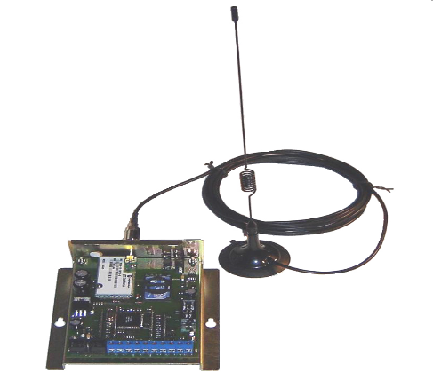
GSM Module
This document describes the hardware interface of the SIMcom SIM300 module that connects to the specific application and the air interface. As SIM300 can be integrated with a wide range of applications, all functional components of SIM300 are described in great detail
This GSM modem is a highly flexible plug and play quad band GSM modem for direct and as integration to rs232.
Supports features like voice, data/fax, SMS, GPRS and integrated TCP/IP stack.
Control via at commands.

Slide 15
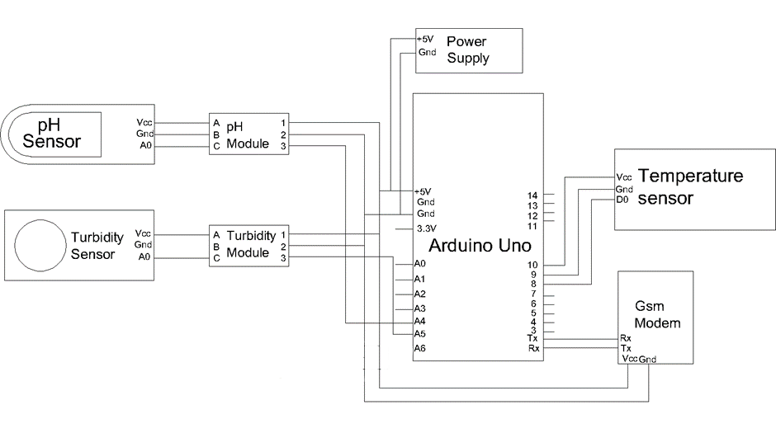
Circuit Diagram

Slide 16
Working
Turbidity is the measure of a number of particles in the water. It is taken as the optical property of water and is an expression of the amount of the light that is scattered by the suspended particles
The temperature sensor used for measuring the temperature of water.When the accurate measurement is needed, we should always consider the temperature.
The increase in temperature of water increases the ionization rate .For example, pH value as well as turbidity changes with the change in Temperature.
pH is temperature dependent, when the temperature goes up, the rate of ionization increases and vice versa. pH sensor is a sensor which detects pH value of water.
The Processed Data will be Sent as SMS using Gsm Modem to Particular Numbers.

Slide 17
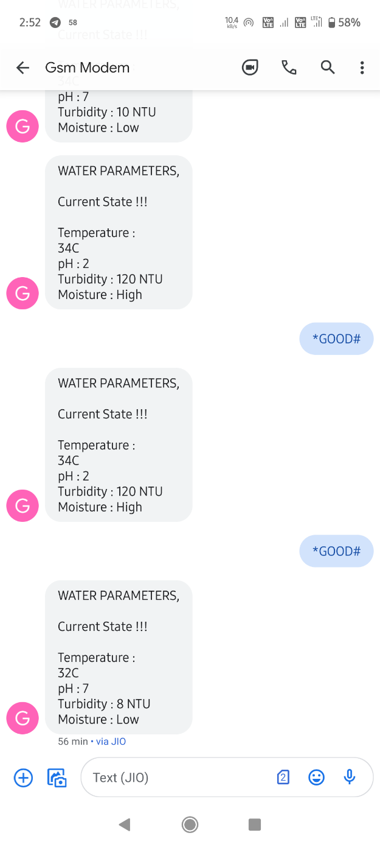
Result
In our system four sensors are connected Temperature, pH and Turbidity are connected to the Arduino UNO.
These four sensor measures of Temperature, pH, and Turbidity parameters of the water when they dipped in water.
Then Arduino UNO will access the data from these sensors and process the data, finally sends the data to registred user using SMS.
which shows the readings of all the sensors measuring Temperature, pH and Turbidity levels of Water from different resources.

Slide 18
Advantages
Due to automation it will reduce the time to measure the parameters.
This is economically affordable for common people.
Low maintenance.
Prevention of water diseases.

Slide 19
Applications
This system is used in commercial and domestic use.
Mainly helpful for Water Supply Agencies.
For health department to identify the reason of water diseases.

Slide 20
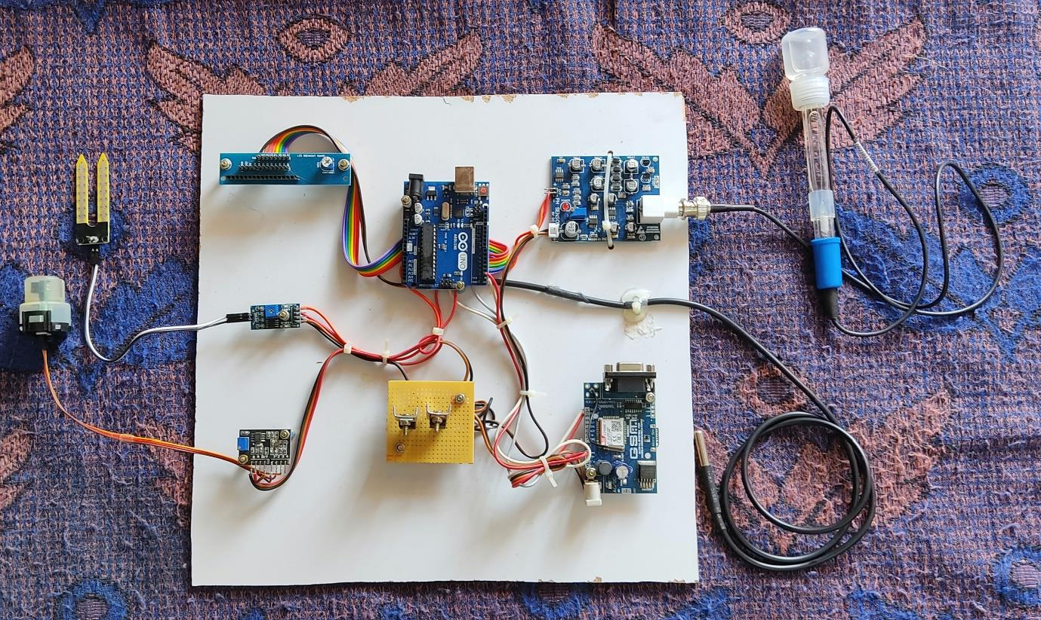
Picture of The Project

Slide 21
Conclusion
Monitoring of Turbidity, PH & Temperature of Water makes use of water detection sensor with unique advantage.
The system can monitor water quality automatically, and it is low in cost and does not require people on duty. So the water quality testing is likely to be more economical, convenient and fast. The system has good flexibility.
Only by replacing the corresponding sensors and changing the relevant software programs, this system can be used to monitor other water quality parameters.
The system can be expanded to monitor hydrologic, air pollution, industrial and agricultural production and so on. It has widespread application and extension value.

Slide 22
Refrences
[1] Poonam J. Chavan, Manoj Mechkul “IoT Based Water quality Monitoring” IJMTER Journal, Vol 3, pp.746-750, April 2016.
[2] Mithali Borbade, Shruti Danve “Real Time Water Quality monitoring system” IJIRCE journal, Vol 3, pp. 5046-5068, June 2015.
[3] Vaishnavi V, Daigovane, Dr.M.A. Gaikwad “Water quality monitoring system based on IoT” Research India publication on Vol 10, pp. 1107 1116, 2017.
[4] Pradeepkumar M. Manisha J.Praveen Sha R. Proiserin V. Suganya Devi K “The real time monitoring of water quality in IoT Environment” IJIRSET, Vol 5, pp. 4419-4427, March 2016.

Slide 23
Thank You…

